Slide 1
Unit 6

Slide 2
Warnock's Algorithm (Area Subdivision Algorithm)-

Slide 3
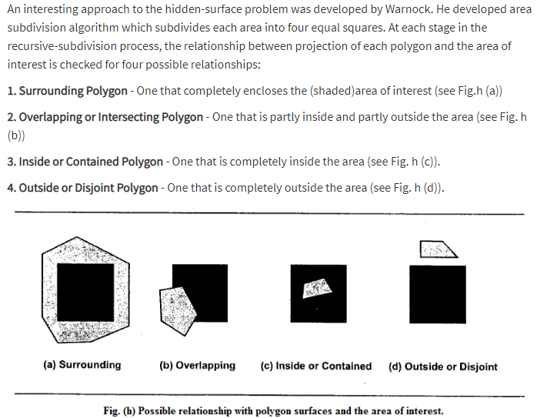

Slide 4
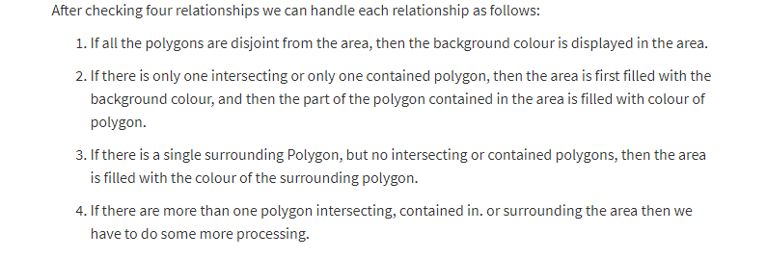

Slide 5
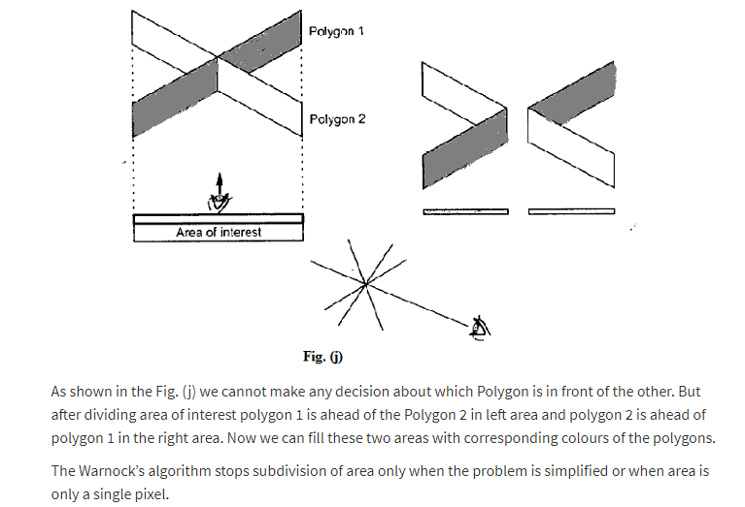

Slide 6
